Slide 1


Office Leave Management System
Submitted by: Kshitij Agarwal
Submission type : Individual
Batch : 12
LMS Id :
Program : Axis Fintech
Date: May 31st, 2023
Source Code : https://github.com/kshitij-agarwal/Office-Leave-Management-System

Slide 2


Introduction
Office Leave Management System is a web-based application developed for the employees to apply for the leave and managers can approve or reject the leave.
The goal of application is to enhance the leave management the process in the office, to simplify the process, increase efficiency and increase overall employee experience.

Slide 3

Project Overview
Functionalities Implemented
Login Feature – Manager and Employee can login separately
Dashboard – Managers and Employees can view their co-workers leaves.
Apply Leave – Exhaustive form where an employee for leave.
Leave Approval – Managers can approve or reject the leave of employees.
Calendar – Employees can view their leaves on calendar.

Slide 4





Project Overview – Technologies Used
Frontend
React
Redux
Ant-design
Backend
Spring-Boot
Java
Database
MongoDB Atlas
MongoDB compass
Postman
Visual Studio Code
Git

Slide 5
Back-end Development
APIs
Employee API – This API will fetch and update the Employees from the database. It handles the dashboard, Leave application, Leave approval and Calendar functionalities.
Login API – This API handles the Login, Logout and Authentication functionalities.
Implementation
Used Lombok to reduce boilerplate code and enhance readability.
Leveraged Spring JPA and Hibernate to access the database efficiently via repository layer.
Used Spring-Mongo dependency to access the data from Mongo Atlas.
To store and retrieve the database credentials, used spring-dotenv dependency from env file.
Added Cross-Origin to access the APIs from React.
Used Postman to test and debug the APIs thoroughly.

Slide 6

Front-end Development
Implementation
React Framework was used to implement the frontend.
Used SCSS instead of CSS to reduce the need for writing the classes repeatedly.
Ant-Design was used to make the application more interactive.
Followed the functional methodology.
Implemented React-Router-DOM and React-Redux for routing and storing data.
DayJS was used to manage the dates.

Slide 7
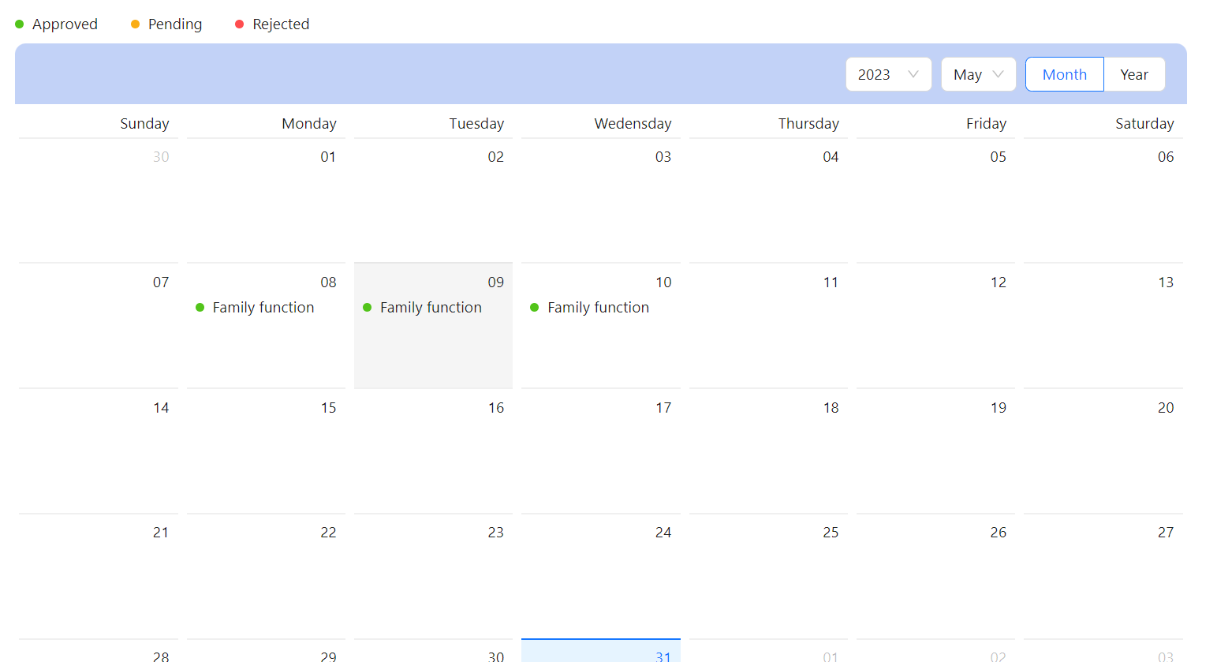
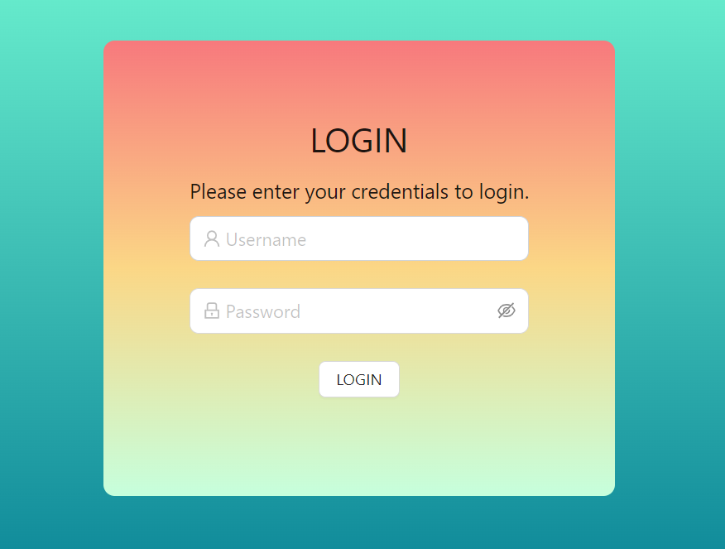
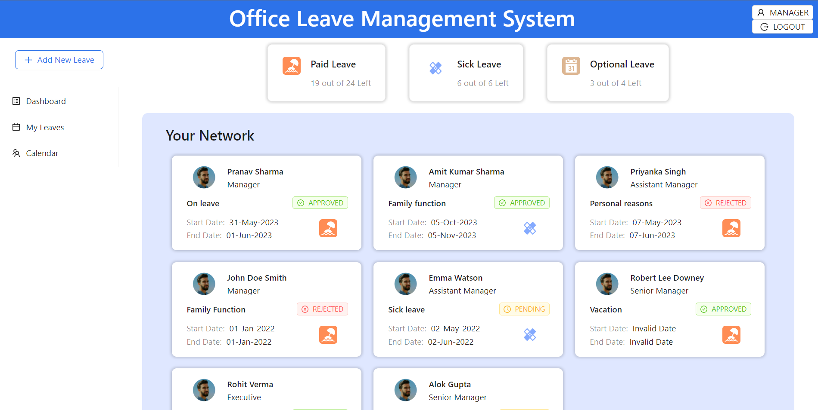
User Interface

Slide 8

Conclusion
Office Leave Management System is a web application which has been developed using React and Spring-Boot for frontend and backend respectively.
MongoDB is deployed at the heart the application to store and retrieve the data.
Some of the salient features are –
Login
Data Rich Dashboard
Leave Application
Leave Approval system
Calendar

Slide 9

Future Work
Following Features to be added in Future –
Exhaustive login functionality for individual admin, managers and employees
Interactive Dashboard
Report Generation
Onboarding new members functionality
Enhance existing functionalities
Deploy the project on cloud

Slide 10
References
React Official Documentation - https://legacy.reactjs.org/docs/getting-started.html
Spring-Boot Official Documentation – https://docs.spring.io/spring-boot/docs/current/reference/htmlsingle/
Ant Design Official Documentation – https://ant.design/components/overview/
Java Documentation – https://docs.oracle.com/en/java/
MongoDB Documentation – https://www.mongodb.com/docs/

Slide 11
References
GitHub project Link - https://github.com/kshitij-agarwal/Office-Leave-Management-System

Slide 12


